Slide 1
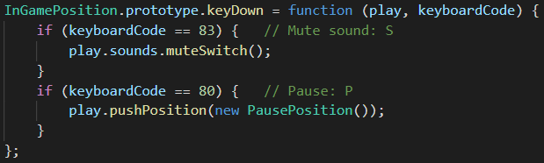
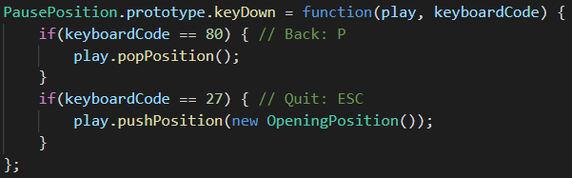
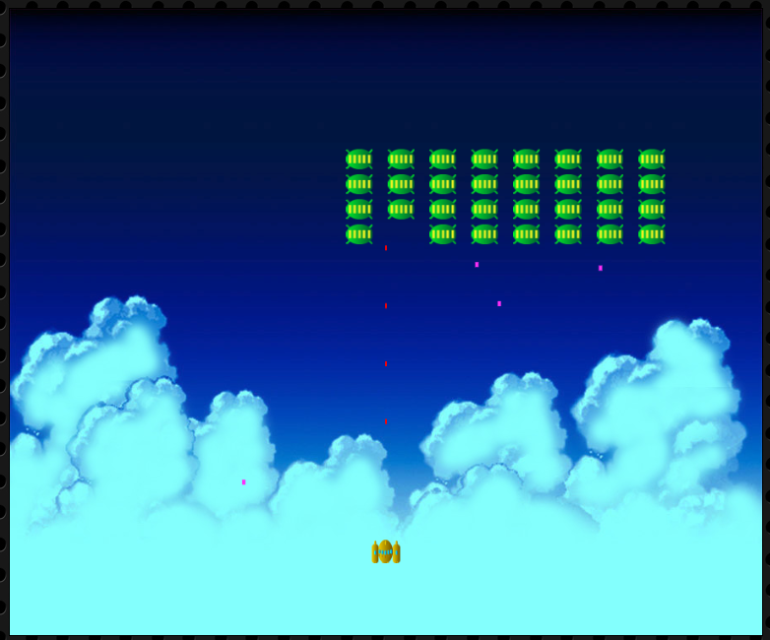

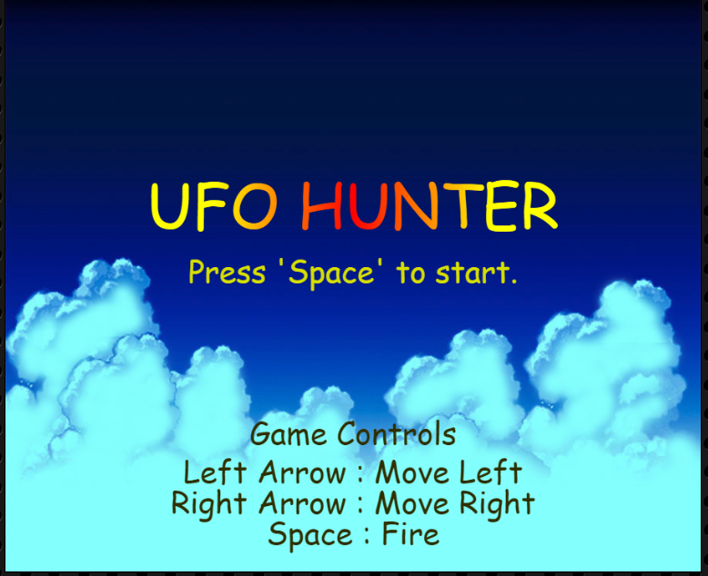
PausePostion
P
positionContainer
InGamePostion
positionContainer
PausePostion
InGamePostion
positionContainer
OpeningPostion
P
ESC

